Slide 1
Business Architecture research & overview
Presenter:
Fred Cummins, OMG BA SIG Co-Chairman
Prof. Mark von Rosing, Global University Alliance Chairman
Notes:
© Copyright note on Intellectual Capital: All rights reserved
LEADing Practice ApS respects the intellectual property of others, and we ask others to do the same. All information and materials contained in the LEAD frameworks, methods and approaches with associated tools and templates, such as maps, matrices and models is Intellectual Capital (IC) and Intellectual Property (IP) of LEADing Practice ApS and limitations apply to the reuse of this IC/IP. The intellectual Property Rights (IPR) consists of information, knowledge, objects, artifacts, experience, insight and/or ideas, that are structured to enable reuse to deliver value creation and realization.
The LEADing Practice ApS intellectual capital is protected by law, including, but not limited to, internationally recognized United States and European Union IPR copyright law. Except as specifically indicated otherwise in writing, LEADing Practice ApS is the owner of the copyright in the entire LEAD Frameworks content (including images, text and look and feel attributes) and LEADing Practice ApS reserves all rights in that regard. Use or misuse of the IPR, the trademarks, service mark or logos is expressly prohibited and may violate country, federal and state law.
LEADing Practice ApS is an open architecture and open standard community and therefore provides open access to all deliverables for certified LEAD practitioners, thereby ensuring that modelling principles are applied correctly. A open architecture and open standard community has been set in place to encourage sharing, learning and reuse of information and thereby increase knowledge among LEAD community practitioners, and with this ultimately improvement of one’s project, engagement and the LEAD development.
Use of the LEAD frameworks, methods and approaches is restricted to certified LEAD community members, in good practitioner standing, who are able to use these items solely for their non-commercial internal use. Legal access to the detail of LEAD will be provided to you with your membership. Members are prohibited from sharing the LEAD material in its entirety with other parties who are not members of LEAD community since the concepts and models are protected by intellectual property rights.
Guidelines for LEAD community members using the IPR material
As a LEAD member comes greater personal responsibility and the following intellectual property conditions apply:
Can be used free of charge for LEAD certified practitioners.
Cannot be share, copied or made available for non-community member, which are not LEAD certified practitioners.
When using any materials, it must include a source notice – either in an adjacent area or as a footnote – to indicate the source. The source should be specified the following way : “Source: A part of the LEAD Frameworks” and possibly indicate the LEAD work product family, such as “Part of LEAD Process Framework”.
Cannot be systematically “given away” – do not download all our content and simply hand it over to other colleagues or clients that are not trained and certified.
To ensure correct usage, any company usage of the LEAD material e.g. templates and tools has to be tailored and agreed upon by LEADing Practice ApS . LEADing Practice ApS may, in appropriate circumstances and at its discretion, terminate the access/accounts of users who infringe the intellectual property rights and pursue legal action.
Guidelines for non-LEAD community members using the IPR material
The following conditions apply to use of the LEAD Intellectual Property for non-community members:
Can be used free of charge for lecturing and research at any University and Business School
Material available at www.LEADframeworks.com can be used in a non-commercial way for knowledge sharing . When using any materials, it must include a source should be specified the following way : “Source: A part of the LEAD Frameworks” and possibly indicate the LEAD work product family, such as “Part of LEAD Process Framework”.
General guidelines that apply for all LEAD IPR material
Any use of original texts, graphics, images, screen shots, and other materials from LEAD sources must be approved by LEADing Practice ApS .
Any material cannot be generally distributed to colleagues, clients and or an undefined audience without written permission from LEADing Practice ApS .
Cannot be altered or changed (the using company) in any way without explicit written permission from LEADing Practice ApS .
In most cases, the LEADing Practice ApS acts as a distribution channel for the Publisher(s) and Authors) of the material provided. LEADing Practice ApS may, in appropriate circumstances of infringement of the intellectual property rights pursue legal action. For questions, please get in touch with us at info@LEADingPractice.com.

Slide 2
Business Architecture Agenda
Business Architecture research
Business Architecture Research Focus
Business Architecture Research Considerations
Business & EA Research: 1765 CEOs and 2936 business leaders representing all major countries on: What is the current state of the EA program?
Lessons Learned Summery
Research Finding - Putting it all together

Slide 3
Business Architecture Agenda
Business Architecture research
Business Architecture Research Focus
Business Architecture Research Considerations
Business & EA Research: 1765 CEOs and 2936 business leaders representing all major countries on: What is the current state of the EA program?
Lessons Learned Summery
Research Finding - Putting it all together

Slide 4
Business Architecture Research Focus
Research Focus
Information and research is sought on topics related to the understanding and comparison of Business Architecture Frameworks (BAFs), including, but not limited to:
Semantic foundations of Business Architecture Frameworks
What common Ontology aspects do the various Business Architecture concepts have?
What common meta objects do they these Business Architecture concepts have?
What common templates/models do the Business Architecture concepts have?
Organization and modularization principles of their Business Architecture concepts
Extension and customization mechanisms for Business Architecture
Comparing Business Architecture method and approaches for comparison
What Business Architecture roles exist

Slide 5
Business Architecture Agenda
Business Architecture research
Business Architecture Research Focus
Business Architecture Research Considerations
Business & EA Research: 1765 CEOs and 2936 business leaders representing all major countries on: What is the current state of the EA program?
Lessons Learned Summery
Research Finding - Putting it all together

Slide 6
Business Architecture Research Considerations
Business Architecture concern considerations:
What are the most common business architecture customer concerns?
What concerns are well-supported (typical concerns tackled by BA)?
What concerns are not currently handled?
Model and viewpoint considerations:
Typical Business Architecture models the organizations work with?
What challenges are being addressed by current BA models?
What challenges are not being addressed by current BA models?
What are the tasks for Business Architecture models used?
Business Architecture LifeCycle considerations:
Which concepts have Business Architecture LifeCycle aspects
What are the Business Architecture LifeCycle phases
What are the Business Architecture LifeCycle tasks
What are the BA LifeCycle roles and which task do they do in the phases
Business Architecture KPI considerations:
Which Business Architecture measures (KPIs) exist
Which framework, method or approach have BA measures
What is the relationship between BA measures and lifecycle

Slide 7
Business Architecture Agenda
Business Architecture research
Business Architecture Research Focus
Business Architecture Research Considerations
Business & EA Research: 1765 CEOs and 2936 business leaders representing all major countries on: What is the current state of the EA program?
Lessons Learned Summery
Research Finding - Putting it all together

Slide 8
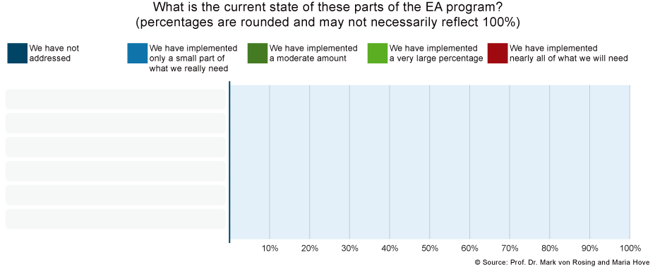
What is the current state of these parts of the EA program?
Source: Global University Alliance (FMI: www.globaluniversityalliance.net/research-areas/business-architecture-research/)
Business & EA Research: 1765 CEOs and 2936 business leaders representing all major countries

Slide 9
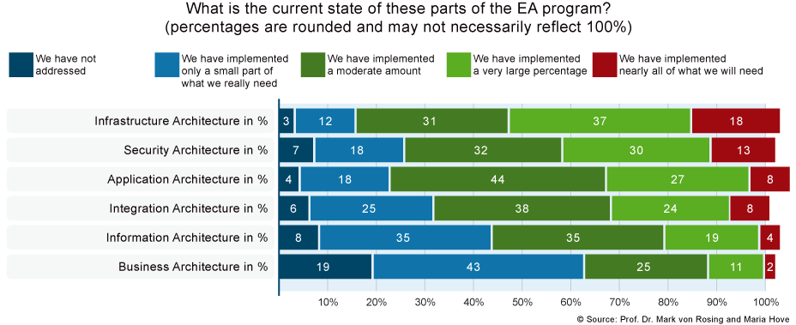
Infrastructure Architecture
Source: Global University Alliance (FMI: www.globaluniversityalliance.net/research-areas/business-architecture-research/)
Business & EA Research: 1765 CEOs and 2936 business leaders representing all major countries

Slide 10
Security Architecture
Source: Global University Alliance (FMI: www.globaluniversityalliance.net/research-areas/business-architecture-research/)
Business & EA Research: 1765 CEOs and 2936 business leaders representing all major countries

Slide 11
Application Architecture
Source: Global University Alliance (FMI: www.globaluniversityalliance.net/research-areas/business-architecture-research/)
Business & EA Research: 1765 CEOs and 2936 business leaders representing all major countries

Slide 12
Integration Architecture
Source: Global University Alliance (FMI: www.globaluniversityalliance.net/research-areas/business-architecture-research/)
Business & EA Research: 1765 CEOs and 2936 business leaders representing all major countries

Slide 13
Information Architecture
Source: Global University Alliance (FMI: www.globaluniversityalliance.net/research-areas/business-architecture-research/)
Business & EA Research: 1765 CEOs and 2936 business leaders representing all major countries

Slide 14
Business Architecture
Source: Global University Alliance (FMI: www.globaluniversityalliance.net/research-areas/business-architecture-research/)
Business & EA Research: 1765 CEOs and 2936 business leaders representing all major countries

Slide 15
Rating of strategic importance
1
Source: Global University Alliance (FMI: www.globaluniversityalliance.net/research-areas/business-architecture-research/)
Business & EA Research: 1765 CEOs and 2936 business leaders representing all major countries

Slide 16
Rating of strategic importance
2
1
Source: Global University Alliance (FMI: www.globaluniversityalliance.net/research-areas/business-architecture-research/)
Business & EA Research: 1765 CEOs and 2936 business leaders representing all major countries

Slide 17
Rating of strategic importance
3
2
1
Source: Global University Alliance (FMI: www.globaluniversityalliance.net/research-areas/business-architecture-research/)
Business & EA Research: 1765 CEOs and 2936 business leaders representing all major countries

Slide 18
Rating of strategic importance
4
3
2
1
Source: Global University Alliance (FMI: www.globaluniversityalliance.net/research-areas/business-architecture-research/)
Business & EA Research: 1765 CEOs and 2936 business leaders representing all major countries

Slide 19
Rating of strategic importance
5
4
3
2
1
Source: Global University Alliance (FMI: www.globaluniversityalliance.net/research-areas/business-architecture-research/)
Business & EA Research: 1765 CEOs and 2936 business leaders representing all major countries

Slide 20
Rating of strategic importance
6
5
4
3
2
1
Source: Global University Alliance (FMI: www.globaluniversityalliance.net/research-areas/business-architecture-research/)
Business & EA Research: 1765 CEOs and 2936 business leaders representing all major countries

Slide 21
Rating of strategic importance
Reasons of choosen area
1
Source: Global University Alliance (FMI: www.globaluniversityalliance.net/research-areas/business-architecture-research/)
Business & EA Research: 1765 CEOs and 2936 business leaders representing all major countries

Slide 22
Rating of strategic importance
Reasons of the rating?
1
Reasons:
Link to Strategy (Strategic Business Objectives )
Improve Competitiveness (growth & cost potential)
Link to Business Model
Service Model Innovation & Transformation
Link to the Critical Success Factors (CSFs) of the organization
Operational Excellence
Source: Global University Alliance (FMI: www.globaluniversityalliance.net/research-areas/business-architecture-research/)
Business & EA Research: 1765 CEOs and 2936 business leaders representing all major countries

Slide 23
Rating of strategic importance
Reasons of the rating?
2
1
Source: Global University Alliance (FMI: www.globaluniversityalliance.net/research-areas/business-architecture-research/)
Business & EA Research: 1765 CEOs and 2936 business leaders representing all major countries

Slide 24
Rating of strategic importance
Reasons of the rating?
2
1
Reasons:
Improve Decision Making
Improve Business Flow
Improve Service Flow
Operational Excellence
Lower Risk
Improve Flexibility & Responsiveness
Source: Global University Alliance (FMI: www.globaluniversityalliance.net/research-areas/business-architecture-research/)
Business & EA Research: 1765 CEOs and 2936 business leaders representing all major countries

Slide 25
Rating of strategic importance
Reasons of the rating?
3
2
1
Source: Global University Alliance (FMI: www.globaluniversityalliance.net/research-areas/business-architecture-research/)
Business & EA Research: 1765 CEOs and 2936 business leaders representing all major countries

Slide 26
Rating of strategic importance
Reasons of the rating?
3
2
1
Reasons:
Improve Insight & Transparency
Improve Business Flow
Improve Service Flow
Operational Excellence
Lower Risk
Strengthen Robustness
Source: Global University Alliance (FMI: www.globaluniversityalliance.net/research-areas/business-architecture-research/)
Business & EA Research: 1765 CEOs and 2936 business leaders representing all major countries

Slide 27
Rating of strategic importance
Reasons of the rating?
4
3
2
1
Source: Global University Alliance (FMI: www.globaluniversityalliance.net/research-areas/business-architecture-research/)
Business & EA Research: 1765 CEOs and 2936 business leaders representing all major countries

Slide 28
Rating of strategic importance
Reasons of the rating?
4
3
2
1
Reasons:
Cut Cost (Automate)
Operational Excellence (Automate)
Improve Business Support
Improve Business Agility
Improve Service Flow
Strengthen Flexibility
Source: Global University Alliance (FMI: www.globaluniversityalliance.net/research-areas/business-architecture-research/)
Business & EA Research: 1765 CEOs and 2936 business leaders representing all major countries

Slide 29
Rating of strategic importance
Reasons of the rating?
5
4
3
2
1
Source: Global University Alliance (FMI: www.globaluniversityalliance.net/research-areas/business-architecture-research/)
Business & EA Research: 1765 CEOs and 2936 business leaders representing all major countries

Slide 30
Rating of strategic importance
Reasons of the rating?
5
4
3
2
1
Reasons:
Compliance (Automate)
Lower Risk
Protect Organization
Strengthen Robustness
Improve Risk Management
Governance
Source: Global University Alliance (FMI: www.globaluniversityalliance.net/research-areas/business-architecture-research/)
Business & EA Research: 1765 CEOs and 2936 business leaders representing all major countries

Slide 31
Rating of strategic importance
Reasons of the rating?
6
5
4
3
2
1
Source: Global University Alliance (FMI: www.globaluniversityalliance.net/research-areas/business-architecture-research/)
Business & EA Research: 1765 CEOs and 2936 business leaders representing all major countries

Slide 32
Rating of strategic importance
Reasons of the rating?
6
5
4
3
2
1
Reasons:
Cut Cost
Standardize
Consolidate
Operational Excellence
IT Governance
Strengthen Robustness
Source: Global University Alliance (FMI: www.globaluniversityalliance.net/research-areas/business-architecture-research/)
Business & EA Research: 1765 CEOs and 2936 business leaders representing all major countries

Slide 33
Business Architecture Agenda
Business Architecture research
Business Architecture Research Focus
Business Architecture Research Considerations
Business & EA Research: 1765 CEOs and 2936 business leaders representing all major countries on: What is the current state of the EA program?
Lessons Learned Summery
Research Finding - Putting it all together

Slide 34
Lessons Learned Summery

Slide 35
Lessons Learned Summery
Business Architecture matters
    Link to strategy is vital for Architectural direction
    Business Model is vital for Improving Competitiveness and Operational Excellence
    BPM & Standardization matters for Cutting Cost (as one of the main drivers)
    Business Information for strategic decision making is vital
    Change of Service Model is the main subject around Business Innovation & Transformation
    Link to the Critical Success Factors (CSFs) of the organization is the key to gather Bus. Req.

Slide 36
Lessons Learned Summery
Business Architecture matters
    Link to strategy is vital for Architectural direction
    Business Model is vital for Improving Competitiveness and Operational Excellence
    BPM & Standardization matters for Cutting Cost (as one of the main drivers)
    Business Information for strategic decision making is vital
    Change of Service Model is the main subject around Business Innovation & Transformation
    Link to the Critical Success Factors (CSFs) of the organization is the key to gather Bus. Req.
Information Systems Architecture (Application & Data) matters
Application & Data Standardization is vital for Cut Cost (cross standardization automation)
Application & Data Consolidation & Harmonization is vital for Cut Cost (cross standardization automation)
Value Matters (value identification, value creation and value realization has to be understood)
Improve IT Service Flow to support the Business Services is vital for cost cutting, customer orientation and value creation
Operational efficiency around custom code changes, application changes, Test mgt, implementation, application integration, interfaces, template changes, Integration, Functional and Regression testing, business process monitoring, change mgt, Control mgt, quality mgt, infrastructure mgt, platform mgt, Incident Management etc.)

Slide 37
Lessons Learned Summery
Business Architecture matters
    Link to strategy is vital for Architectural direction
    Business Model is vital for Improving Competitiveness and Operational Excellence
    BPM & Standardization matters for Cutting Cost (as one of the main drivers)
    Business Information for strategic decision making is vital
    Change of Service Model is the main subject around Business Innovation & Transformation
    Link to the Critical Success Factors (CSFs) of the organization is the key to gather Bus. Req.
Information Systems Architecture (Application & Data) matters
Application & Data Standardization is vital for Cut Cost (cross standardization automation)
Application & Data Consolidation & Harmonization is vital for Cut Cost (cross standardization automation)
Value Matters (value identification, value creation and value realization has to be understood)
Improve IT Service Flow to support the Business Services is vital for cost cutting, customer orientation and value creation
Operational efficiency around custom code changes, application changes, Test mgt, implementation, application integration, interfaces, template changes, Integration, Functional and Regression testing, business process monitoring, change mgt, Control mgt, quality mgt, infrastructure mgt, platform mgt, Incident Management etc.)
Technology Architecture (Platform & Infrastructure) matters
Platform & Infrastructure Standardization is vital for Cut Cost (cross standardization automation)
Platform & Infrastructure Consolidation & Harmonization is vital for Cut Cost (cross standardization automation)
Improve Platform & Infrastructure Services to support the Business Services is vital for cost cutting, customer orientation and value creation
Operational efficiency of Platform & Infrastructure around Test mgt, standardization, implementation, integration, platform changes, infrastructure monitoring, change mgt, Control mgt, backup, quality mgt, infrastructure mgt, platform mgt, Incident Management etc.

Slide 38
Business Architecture Agenda
Business Architecture research
Business Architecture Research Focus
Business Architecture Research Considerations
Business & EA Research: 1765 CEOs and 2936 business leaders representing all major countries on: What is the current state of the EA program?
Lessons Learned Summery
Research Finding - Putting it all together

Slide 39
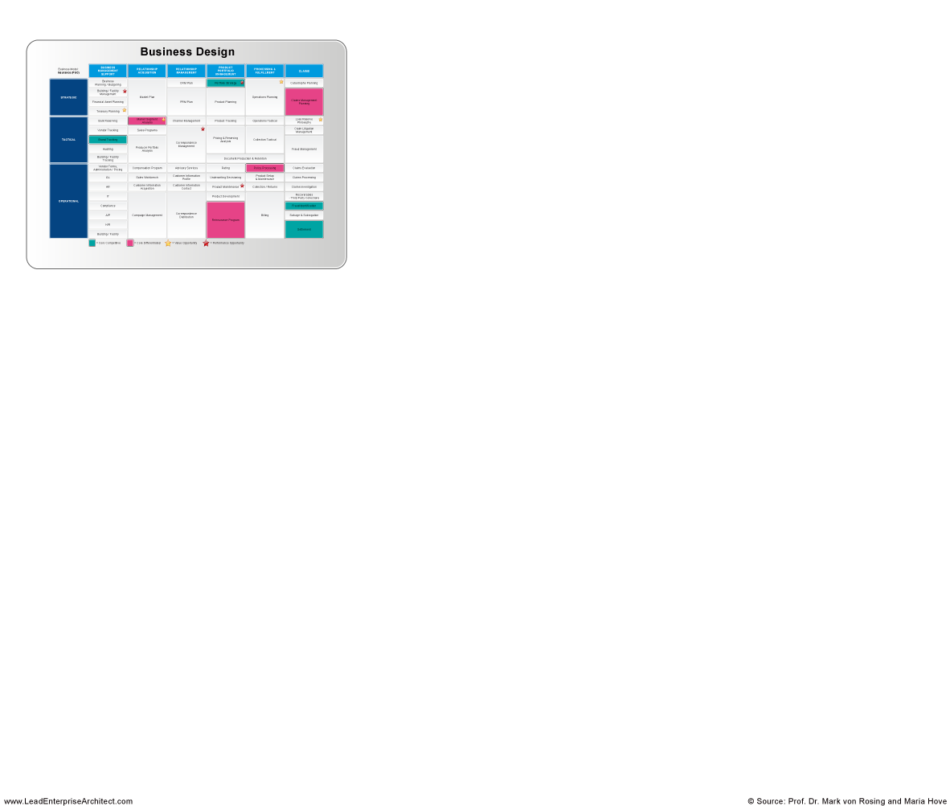
Research Finding - Putting it all together:
Business Design is the basis for the Business Architecture
LEADing Practice Business & IT Alignment
Source: Global University Alliance
(FMI: www.globaluniversityalliance.net/research-areas/business-architecture-research/)

Slide 40
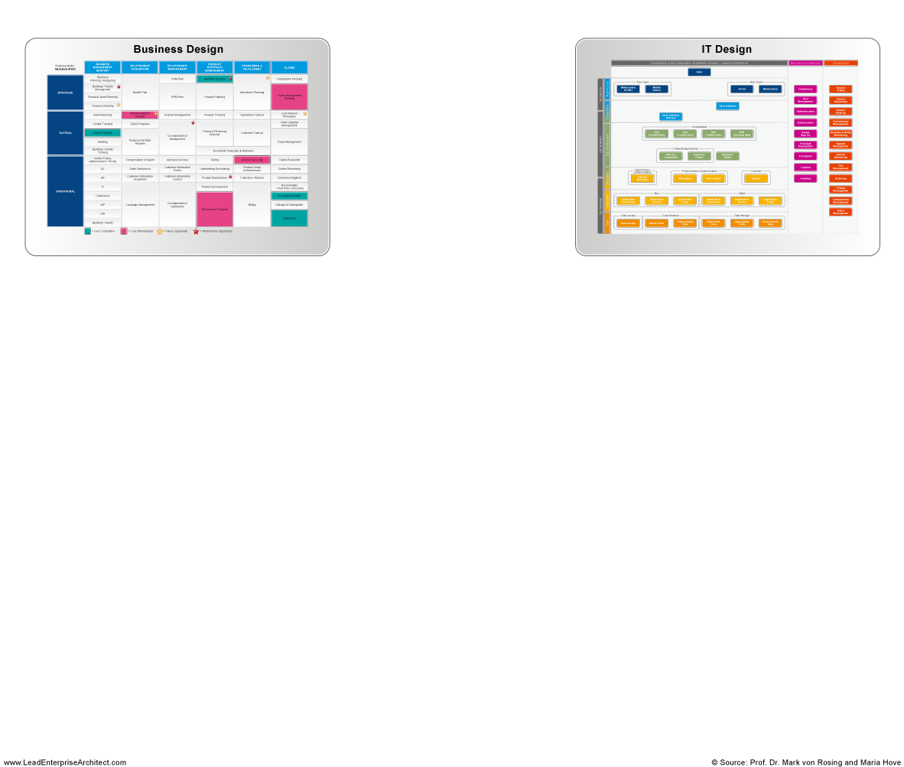
Research Finding - Putting it all together:
IT Design is to often a siloed view of a specific business need and requirement
LEADing Practice Business & IT Alignment
Source: Global University Alliance
(FMI: www.globaluniversityalliance.net/research-areas/business-architecture-research/)

Slide 41
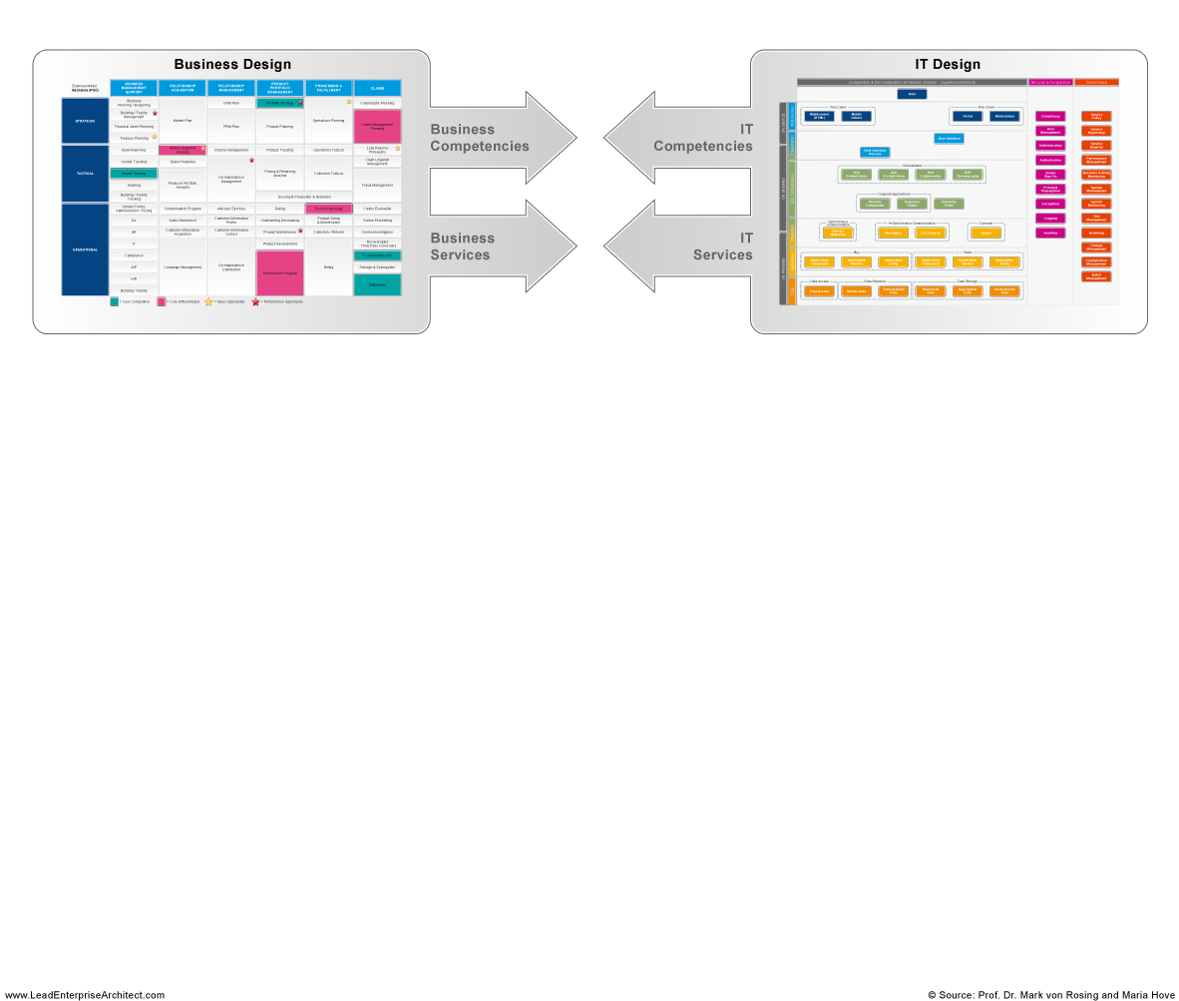
Research Finding - Putting it all together: Executives expect a link between Business and IT concepts
LEADing Practice Business & IT Alignment
Source: Global University Alliance
(FMI: www.globaluniversityalliance.net/research-areas/business-architecture-research/)

Slide 42
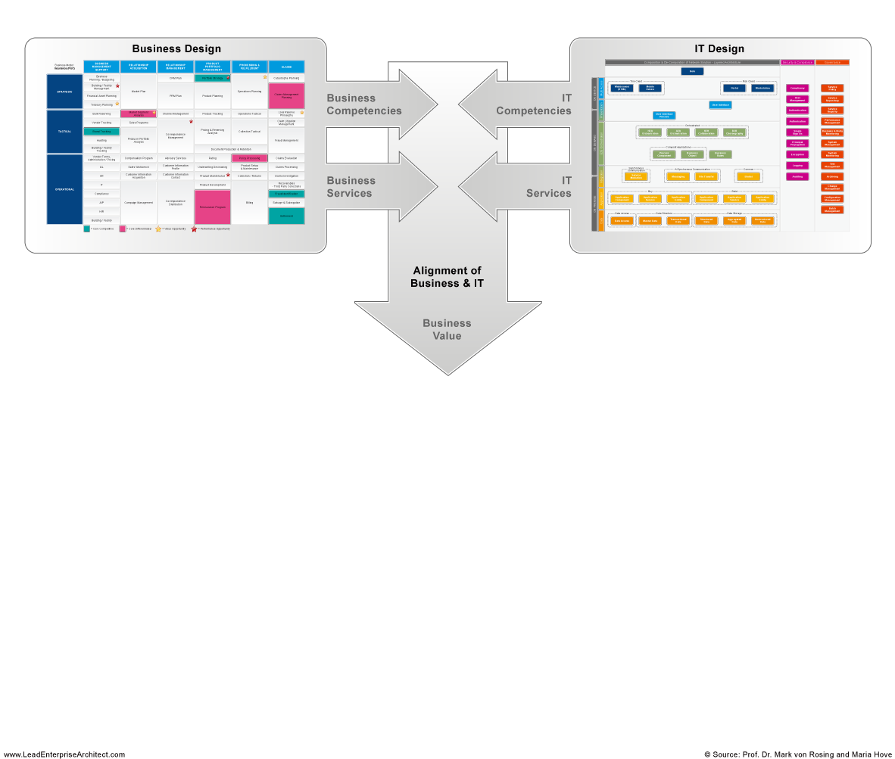
Research Finding - Putting it all together: Alignment of Business & IT with the focus on value creation
LEADing Practice Business & IT Alignment
Source: Global University Alliance
(FMI: www.globaluniversityalliance.net/research-areas/business-architecture-research/)

Slide 43
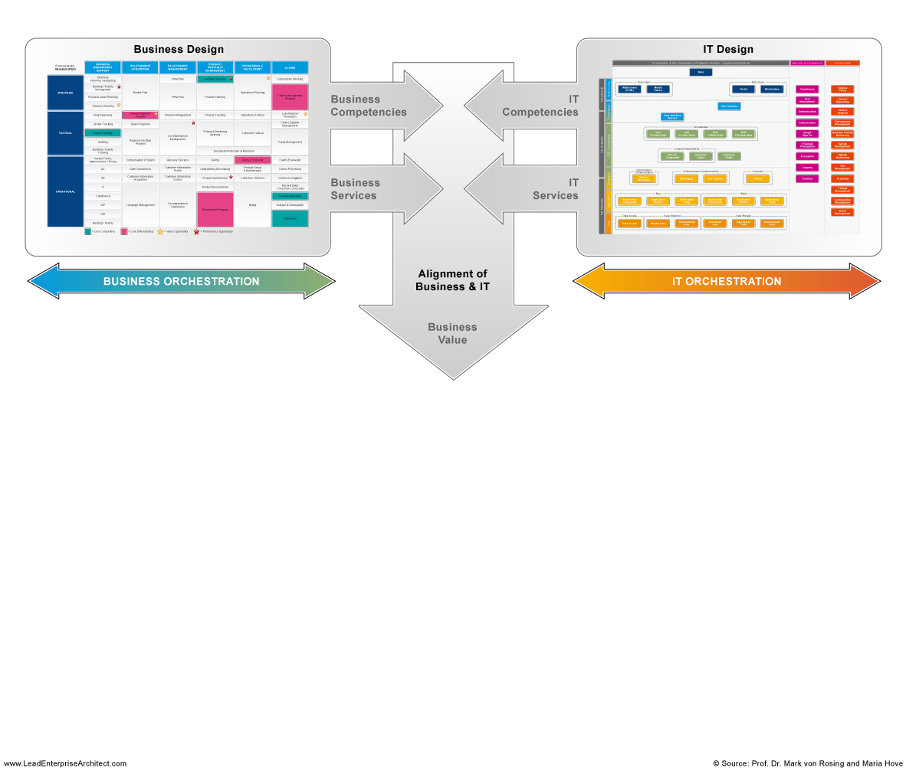
Research Finding - Putting it all together: Executives understand that there is a need for Business Orchestration and IT Orchestration (alignment)
LEADing Practice Business & IT Alignment
Source: Global University Alliance
(FMI: www.globaluniversityalliance.net/research-areas/business-architecture-research/)

Slide 44
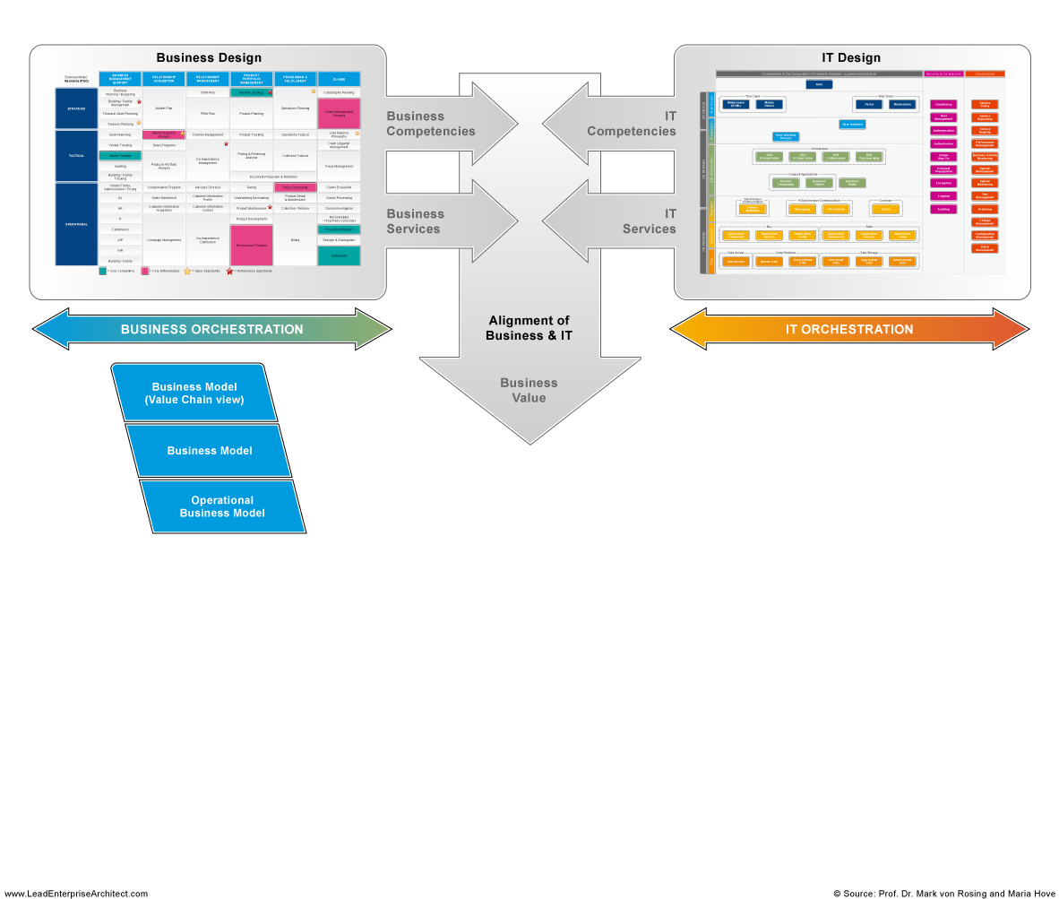
Research Finding - Putting it all together:
Business Model matters: from the highest level of value chain to the operating model
LEADing Practice Business & IT Alignment
Source: Global University Alliance
(FMI: www.globaluniversityalliance.net/research-areas/business-architecture-research/)

Slide 45
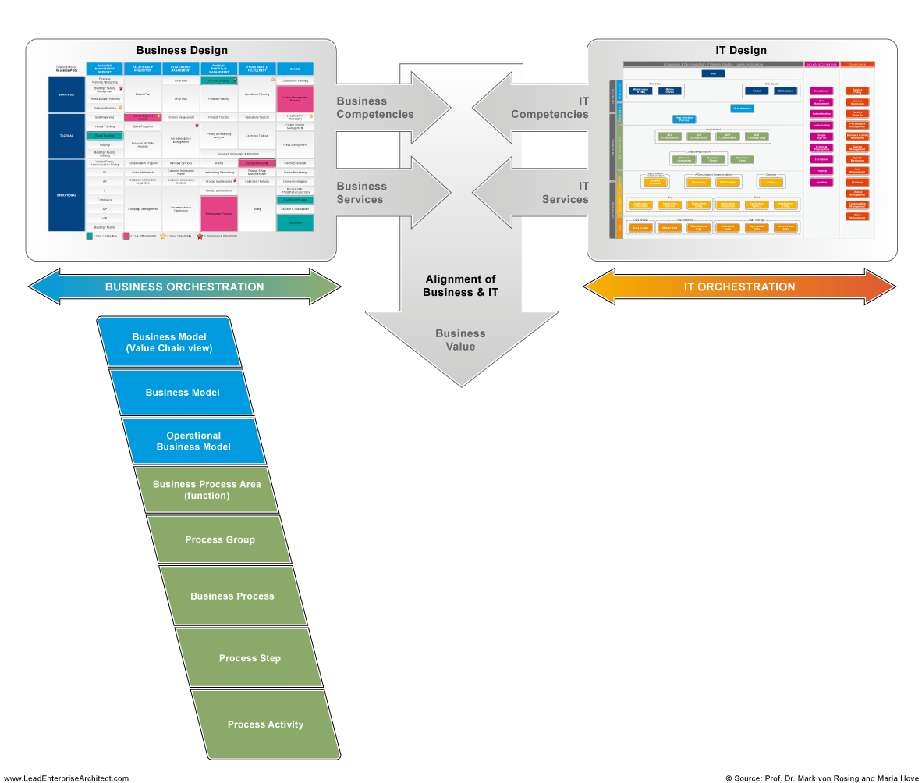
Research Finding - Putting it all together: Business Process matters to ensure effectiveness and efficiency
LEADing Practice Business & IT Alignment
Source: Global University Alliance
(FMI: www.globaluniversityalliance.net/research-areas/business-architecture-research/)

Slide 46
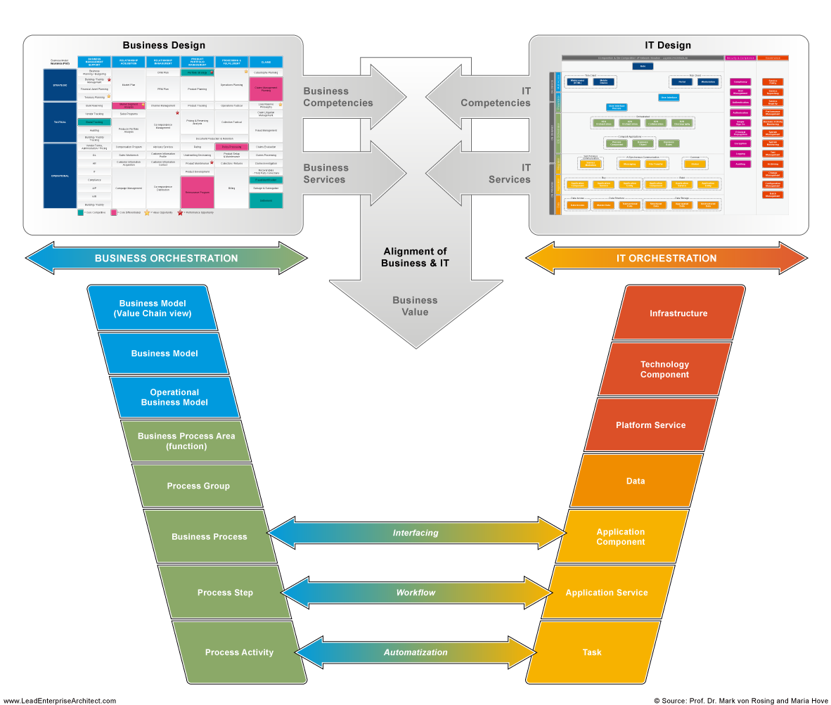
Research Finding - Putting it all together:
Business Architecture is used for Automatization, Workflow & Interfaces
LEADing Practice Business & IT Alignment
Source: Global University Alliance
(FMI: www.globaluniversityalliance.net/research-areas/business-architecture-research/)

Slide 47
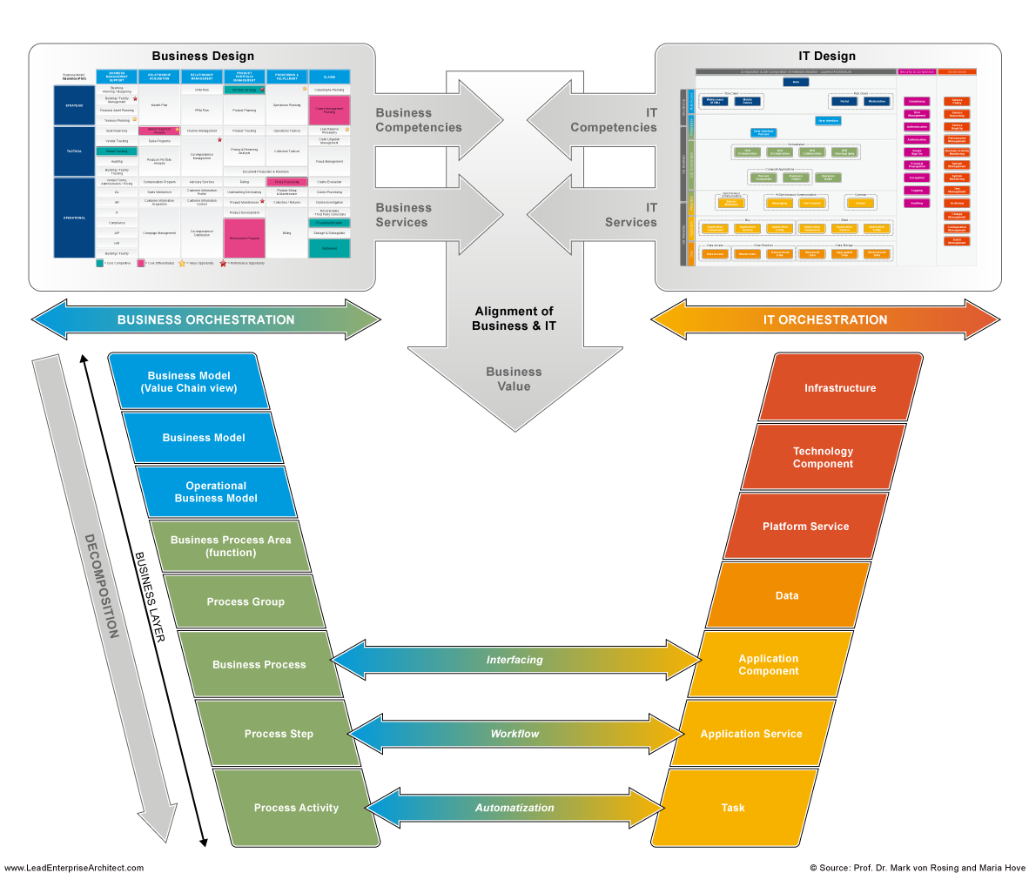
Research Finding - Putting it all together: Decomposition of the Business Layer
LEADing Practice Business & IT Alignment
Source: Global University Alliance
(FMI: www.globaluniversityalliance.net/research-areas/business-architecture-research/)

Slide 48
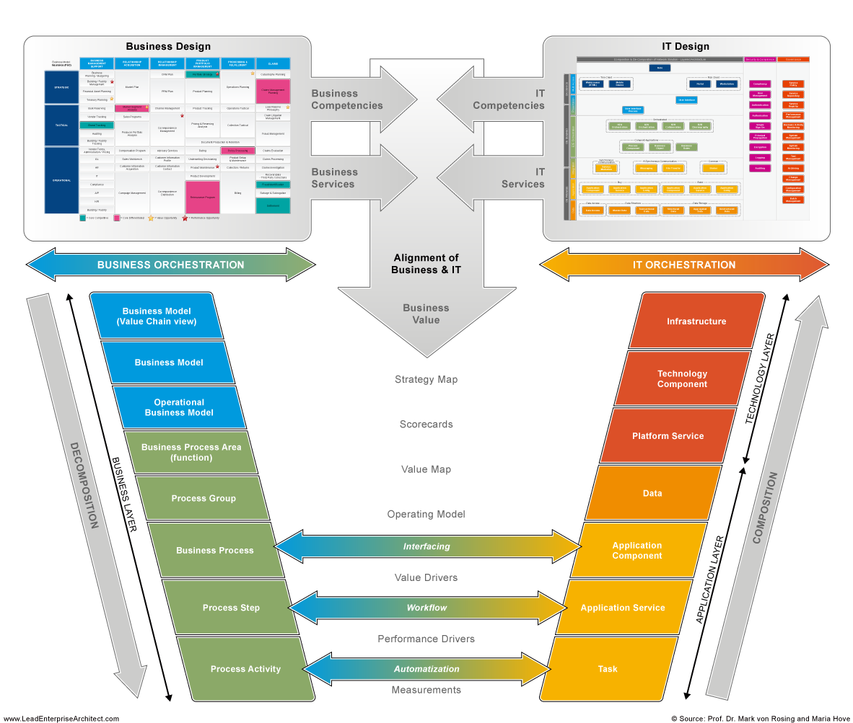
Matters for the Composition of the Application Layer and the Technology Layer
LEADing Practice Business & IT Alignment
Source: Global University Alliance
(FMI: www.globaluniversityalliance.net/research-areas/business-architecture-research/)

Slide 49
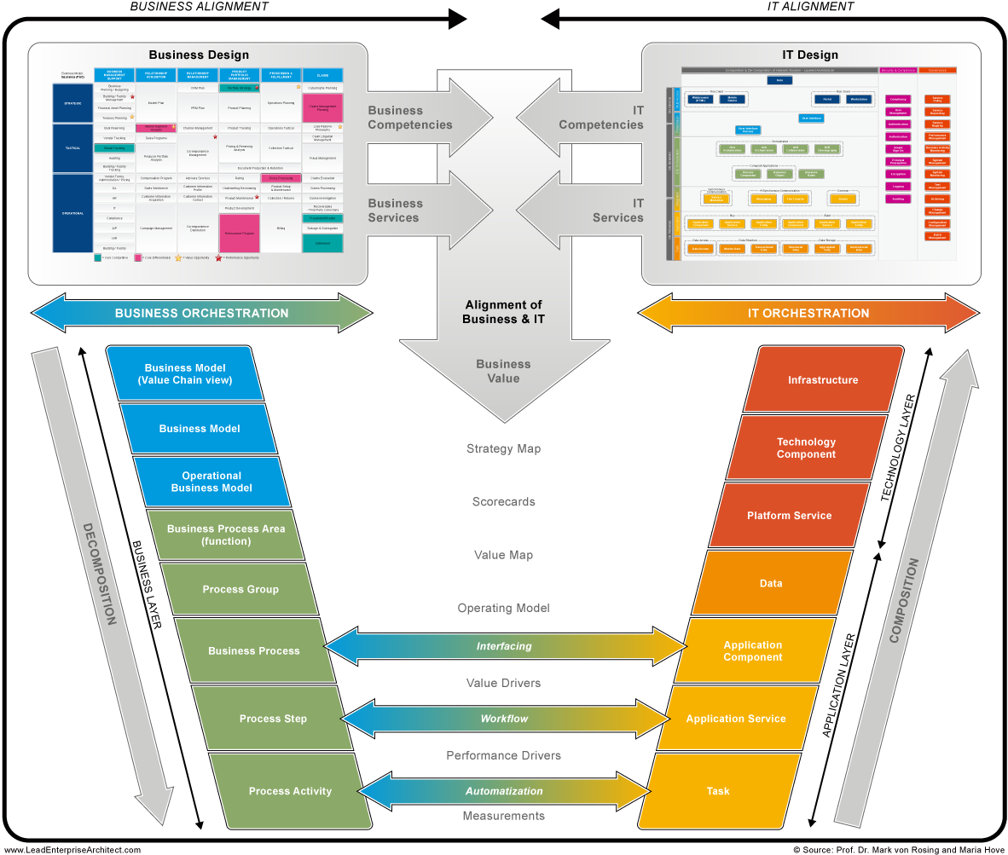
Research Finding - Putting it all together: Business Architecture is more that only a business blueprint or capability mapping it is the basis for Innovation & Transformation of Business & IT
BA
LEADing Practice Business & IT Alignment
Source: Global University Alliance
(FMI: www.globaluniversityalliance.net/research-areas/business-architecture-research/)

Slide 50
Additional Information on the Business Architecture research
http://www.globaluniversityalliance.net/research-areas/business-architecture-research/
Examples of research findings can be found here:
Buisness Architecture Framework overview
Business Architecture Taxonomy (most comon taxonomy used)
The 25 most common Business Architecture Artifacts used
Example of Business Architecture Blueprint, Decomposition and composition into an ERP SAP environment

